Slide 1

6CS005
High Performance Computing
Lecture 11
Decoding and encoding PNG files using the LodePNG library

Slide 2
Decoding a PNG file
Within an image/frame (video), there are many pixels. Pixels commonly are generated from RGB (red, green and blue) values. We will be using a library called “lodepng” which adds in a fourth value which represents transparency.
Single pixel processing is the manipulation of one pixel using a simple formula. For image negative, you will be using an “inverse” method which simply reverses the RGB values.

Slide 3
Decoding a PNG file
We have the following 4x4 image (fairly small image):
The top left is made up of 2x2 R = 40 G = 23 B = 255 T = 255 The top right is made up of 2x2 R = 255 G = 36 B = 36 T = 255
The bottom left is made up of 2x2 R = 255 G = 203 B = 23 T = 255 The bottom right is made up of 2x2 R = 34 G = 177 B = 76 T = 255

Slide 4
Decoding a PNG file – function from library
lodepng has many methods to decode an image. The most simple function is “lodepng_decode32_file(unsigned char ** image, unsigned* w, unsigned * h, const char* filename){ //decoding algorithm}.”
The first parameter takes in the address of a pointer variable which will hold the array of numbers (RGBT).
The second and third parameter will return the height and width of the file that has been loaded in.
The fourth parameter is the “filename” of the PNG image we want to process.

Slide 5
unsigned int error; unsigned char* image; unsigned int width, height;
Decoding a PNG file - code within the main (Part 1)
error = lodepng_decode32_file(&image, &width, &height, filename);
if(error){
printf("error %d: %s\n", error, lodepng_error_text(error));
}

Slide 6
printf("width = %d height = %d\n", width, height);
Decoding a PNG file - code within the main (Part 2)
for(int i = 0; i<height*width*4; i=i+4){
printf("%d %d %d %d\n", image[i], image[1+i], image[2+i], image[3+i]);
}

Slide 7
Decoding
Notice that the array begins with the data from the top row. In this example, we get blue, blue, red, red, blue, blue, red, red, yellow, yellow, green, green, yellow, yellow, green and green.
The transparency value for this example is 255 which means no part of the pixel is seen through (opaque). Some images will have sections which will be completely transparent therefore this value will be 0.

Slide 8
Encoding
The last part of any image processing is encoding the processed array into an image. Before, we used the decode function, now, we will use the encode function.
lodepng_encode32_file(const char* filename, const unsigned char* image, unsigned w, unsigned h)
This function requires the new name of the file you wish to generate (filename) and the array of numbers you pass in (image (RGBT values)).

Slide 9
Demonstration
During the workshop, there will be a demonstration of applying a negative filter on an image in regular C and in CUDA.
NOTE – the regular C program we will create requires lodepng.c. For CUDA, the library input on the command line needs to be a c++ file and therefore we will be using lodepng.cpp.
For regular c 🡪 gcc filename.c lodepng.c
For CUDA 🡪 nvcc filename.c lodepng.cpp

Slide 10
Converting a single array image into a 2D array

Slide 11
Recap – decoding and encoding
We covered how to take a PNG image, decode the RGBT (Red, Green, Blue and Transparency) values into a single dimensional array and then encode the same values back into a new image. We used the following functions from the library:
unsigned lodepng_decode32_file(unsigned char** image, unsigned* w, unsigned* h, const char* filename)
unsigned lodepng_encode32_file(const char*
char*
generatedFilename, const unsigned
image, unsigned w, unsigned h)

Slide 12
Problems with single array image data
Single array images are great for single pixel manipulation. For example, if we have the following 2x2 single pixel array:
{237,28,36,255,34,177,76,255,255,242,0,255,237,2
8,36,255}
We can add some noise to the image by changing the values, lets add 50 to each COLOUR value depending on if the value is less than 205 (as max is 255). Our new image array will hold the following values:
{237,78,86,255,84,227,126,255,255,242,50,255,237
,78,86,255}

Slide 13
Multi-pixel processing with 1D array (6x4)
237,28,36,255,237,28,36,255,34,177,76,255,34,177
,76,255,255,242,0,255,255,242,0,255,237,28,36,25
5,237,28,36,255,34,177,76,255,34,177,76,255,255,
242,0,255,255,242,0,255,127,127,127,255,127,127,
127,255,63,72,204,255,63,72,204,255,185,122,87,2
55,185,122,87,255,127,127,127,255,127,127,127,2
55,63,72,204,255,63,72,204,255,185,122,87,255,18
5,122,87,255
The above array represents a 6x4 image however, in single dimension, it’s very hard to know which pixel is at which coordinate. Let’s format the data into it’s correct orientation

Slide 14
Single dimension to 2D array
Single array data holds pixels in sequence. It’s not very easy to detect the surrounding pixels of 1 single pixel.
Inputs needed to create a 2D array:
Width of image
Height of image
Number of values per pixel (for this library, we use 4).

Slide 15


The 6x4 image

Slide 16
Main code
unsigned int error; unsiunsigned char* image; unsigned int width; unsigned int height;
const char* filename = argv[1];
The “error” variable will hold a number based on whether the conversion from a PNG file was successful or not. This will then be used to print out the error to the user.

Slide 17
error = lodepng_decode32_file(&image, &width, &height, filename);
Main Code
if(error){
printf("error %u: %s\n", error, lodepng_error_text(error));
}
Our single array variable “image.”
has been stored into the The variables “height” and
“width” hold the dimensions of the image. The filename variable is what we will specify within the command line arguments (index 1).

Slide 18
Main Code – creating 2D array variable in C
You can create a 2D array in C using the following syntax:
VariableType nameOfVariable[rowSize][ColSize];
For our program, the variable type is an “unsigned char,” and the dimensions are height as our rows, and width*4 (4 values per pixel) for our columns.

Slide 19
Populating the 2D Array - Theory
We will take that horrible long list of numbers and format it into a 6x4 matrix. This is simply 4 rows of data which holds 24 values. The 24 values is derived by the total of pixels in the “x” multiplied by 4 (RGBT).
The end product should look like the following:
237,28,36,255,237,28,36,255,34,177,76,255,34,177,76,255,255,242
,0,255,255,242,0,255
127,127,127,255,127,127,127,255,63,72,204,255,63,72,204,255,18
5,122,87,255,185,122,87,255
237,28,36,255,237,28,36,255,34,177,76,255,34,177,76,255,255,242
,0,255,255,242,0,255
127,127,127,255,127,127,127,255,63,72,204,255,63,72,204,255,18
5,122,87,255,185,122,87,255

Slide 20
Main code – populating 2D array
for(int row=0; row<height; row++){
for(int col=0; col<width*4; col=col+4){
image2D[row][col]=image[(row*width*4)+col]; image2D[row][col+1]=image[(row*width*4)+col+1]; image2D[row][col+2]=image[(row*width*4)+col+2]; image2D[row][col+3]=image[(row*width*4)+col+3]; }
}
We use 2 nested for loops which act as coordinate counters for our 2D array. We jump every 4 values for the width as each pixel holds 4 attributes.

Slide 21
for(int row1=0; row1<height; row1++){ for(int col1=0; col1<width*4; col1++){
Print contents of 2D array
printf("%d ", image2D[row1][col1]);
if((col1+1)%4 == 0){
printf("| ");
}
}
printf("\n");
}

Slide 22
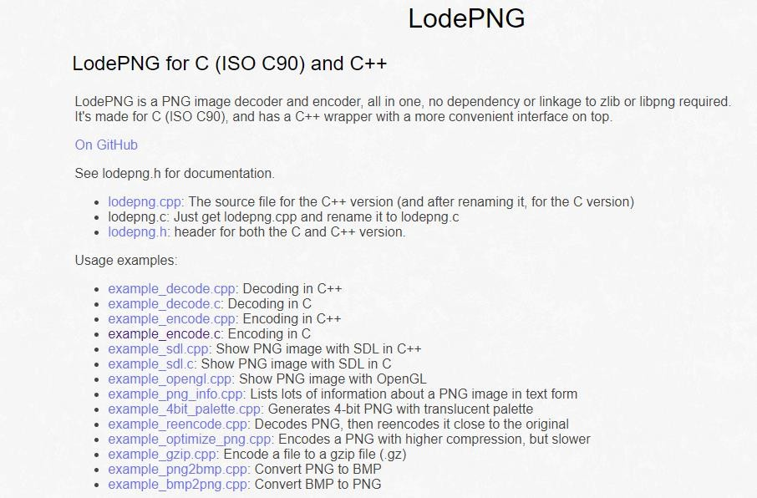
References
https://lodev.org/lodepng/

Slide 23
End of Tutorial 11

